Slide 1
Theory of Computation
CSE 3101
Lecture # 07
Md. Manowarul Islam
Lecturer, Dept of CSE
Jagannath University

Slide 2

NFA example
An NFA that accepts all binary strings that end with 101.

Slide 3

NFA example
An NFA that accepts all binary strings that end with 101.

Slide 4

NFA example
An NFA for a* +(ab)*
  No Input can possible {ε}

Slide 5

NFA example
An NFA for a* +(ab)*
  No Input can possible {ε}
  May be one a or more from a*
a, aa, aaa,…

Slide 6

NFA example
An NFA for a* +(ab)*
  No Input can possible {ε}
  May be one a or more from a*
  May be one or more ab from (ab)*
ab

Slide 7
NFA example
An NFA for a* +(ab)*
  No Input can possible {ε}
  May be one a or more from a*
  May be one or more ab from (ab)*
abab, ababab, …

Slide 8
NFA example
An NFA for a* +(ab)*
  No Input can possible {ε}
  May be one a or more from a*
  May be one or more ab from ab*

Slide 9
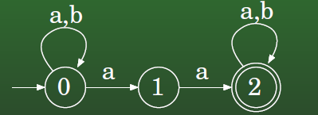

NFA example
Example: L = {w ∈ {a, b} : w contains the substring aa}
  (a+b)*aa(a+b)*
aa

Slide 10
NFA example
Example: L = {w ∈ {a, b} : w contains the substring aa}
  (a+b)*aa(a+b)*
aab, aaa, aabb

Slide 11
NFA example
Example: L = {w ∈ {a, b} : w contains the substring aa}
  (a+b)*aa(a+b)*
baab, abaab

Slide 12
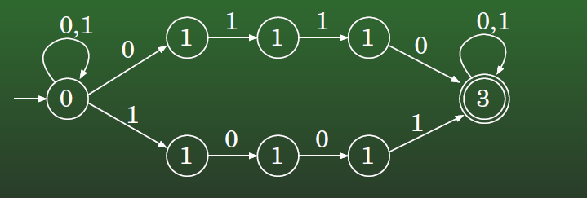

NFA example
All strings over {0, 1} that contian 0110 or 1001
0110

Slide 13
NFA example
All strings over {0, 1} that contian 0110 or 1001
1001

Slide 14
NFA example
All strings over {0, 1} that contian 0110 or 1001
011001

Slide 15
NFA example
All strings over {0, 1} that contian 0110 or 1001
01011001

Slide 16
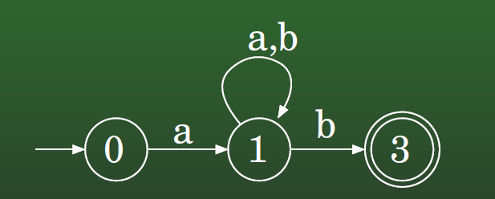

NFA example
All strings over {a, b} that start with a and end with b
  ONLY a and b
ab

Slide 17
NFA example
All strings over {a, b} that start with a and end with b
  ONLY a and b
ab, abb, abab…..

Slide 18
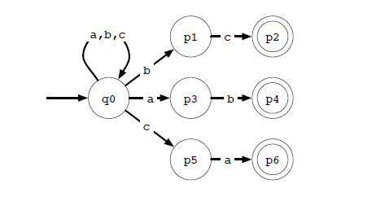
NFA Example
An NFA for the language of all strings over {a, b, c} that end with one of ab, bc, and ca.

Slide 19
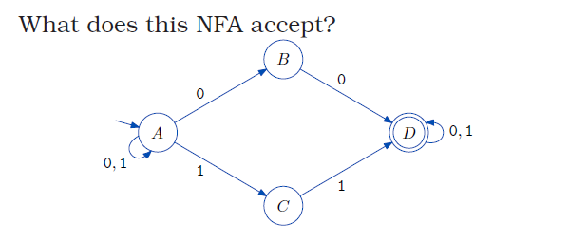

NFA example

Slide 20
END

